Slide 1
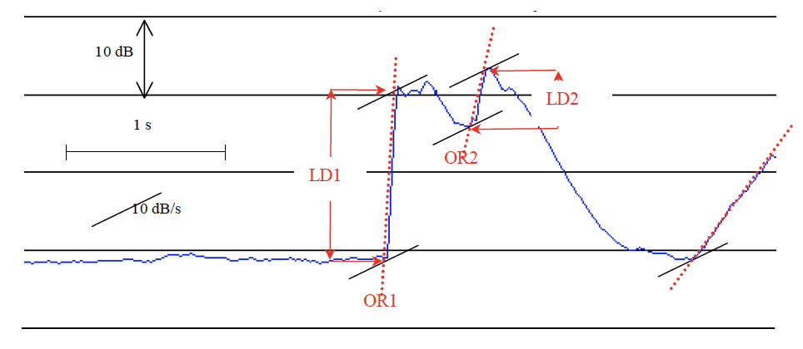
Impulsivity
Impulsivity: the sudden onset of a sound
Defined as combination of onset rate (dB/s) and level difference (ΔdB) for periods when gradient exceeds 10 dB/s
Standard: Nordtest Method: NT ACOU 112 (2002)
Hardware requirements
IEC Class 1 equipment
Electric background noise 10 dB lower
than acoustic background noise
Data processing requirements
A-weighted SPL
Time weighting “F” or “Fast”
(125 ms time constant)
10-25 ms sample period

Slide 2
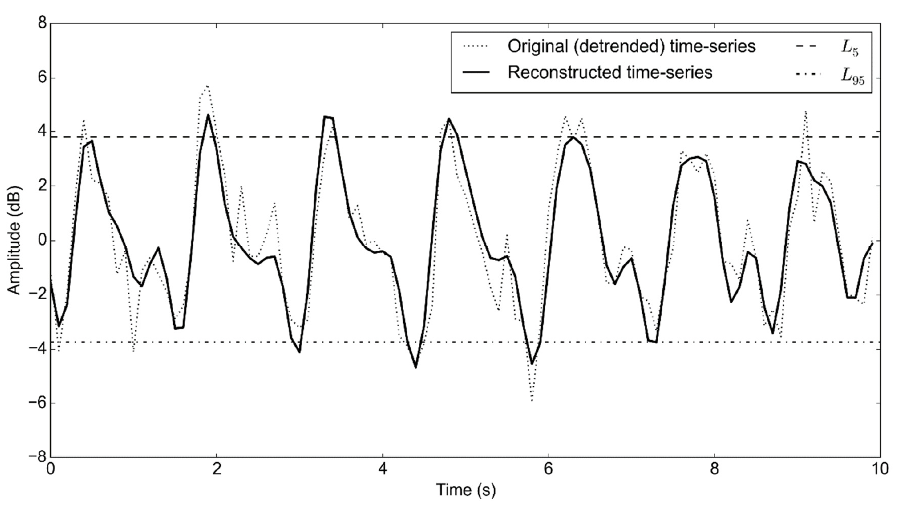
Amplitude Modulation
Amplitude modulation: “periodic fluctuations in the level of audible noise from a wind turbine (or wind turbines), the frequency of the fluctuations being related to the blade passing frequency of the turbine rotor(s)”
Peak to peak amplitude of fundamental modulation frequency and harmonics over a 10 s period, if energy in fundamental frequency is > 4 times the masking level
AM exists if > 50% of 10 s periods in a 10-minute block meet the above requirement
Standard: Institute of Acoustics Noise Working Group (Wind Turbine Noise) Amplitude Modulation Working Group Final Report: A method for rating amplitude modulation in wind turbine noise (2016)

Slide 3
Amplitude Modulation
Hardware requirements
Measurement according to IOA’s Good Practice Guide to the Assessment and Rating of Wind Turbine Noise (IOA NWG, 2013)
AM quantification method intended to be applied from residential distances, typically greater than 500 m
lower limit of instrument linearity range shall be no higher than 25 dB(A)
No specific requirements for wind conditions tested under, but as broad as possible for the site and typical of complaint periods if any
Data processing requirements
A-weighted 1/3 octave band SPL
100 ms sample period, 10 consecutive minutes
3 filter bands considered: 50-200, 100-400, 200-800 Hz

Slide 4
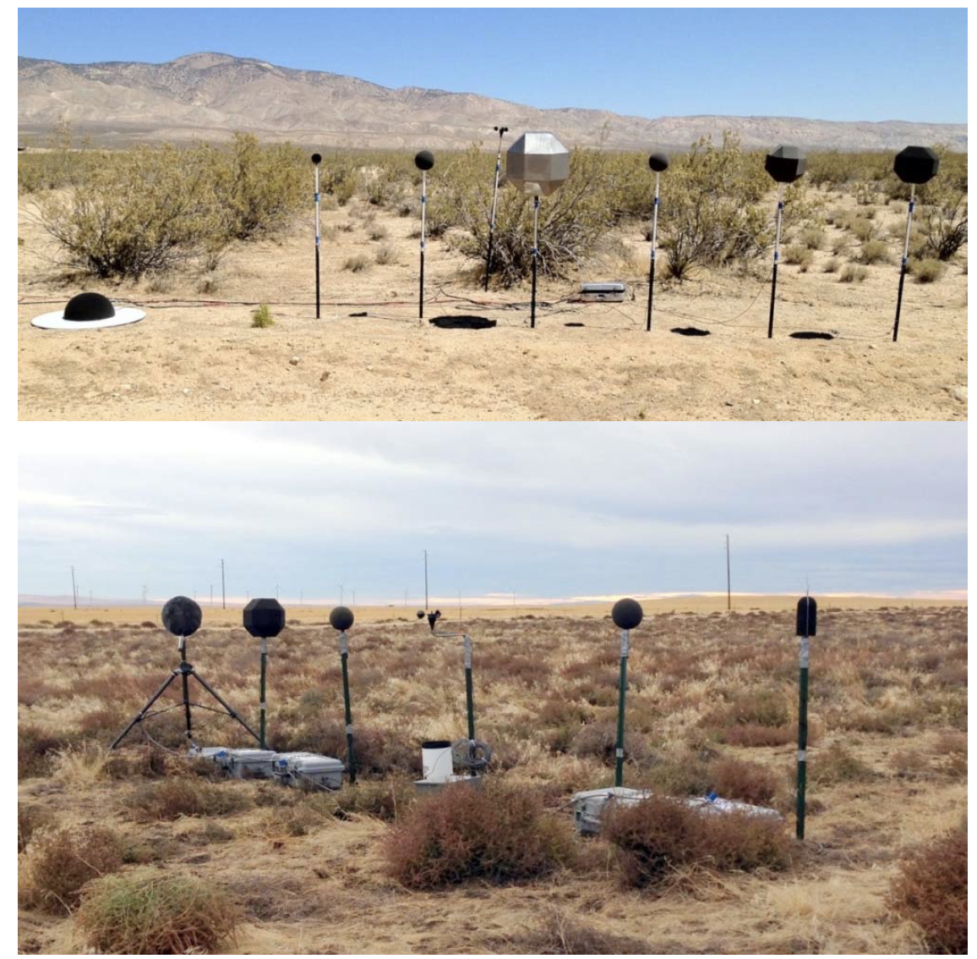
Low Frequency and Infrasound
Low frequency noise (LFN): 1/3 octave bands centered at 20 – 200 Hz
Infrasound noise: 1/3 octave bands centered < 20 Hz
ILFN: Infrasound + LFN (0.5 – 200 Hz)
Standard: ANSI/ASA S12.9-2016/Part 7: Quantities and Procedures for Description and Measurement of Environmental Sound, Part 7: Measurement of Low-frequency Noise and Infrasound Outdoors and in the Presence of Wind and Indoors in Occupied Spaces

Slide 5
Low Frequency and Infrasound
Hardware requirements
Survey grade: general or routine-purpose situations
LFN frequency response
+/- 1dB in 1/3 octave bands from 20 – 200 Hz
ILFN frequency response
+/- 1dB in 1/3 octave bands from 3.5 – 200 Hz
+/- 3dB in 1/3 octave bands from 0.5 – 2.5 Hz
LFN
The microphone shall include a 175 mm windscreen recommended by the manufacturer or better
ILFN
The microphone shall include a 300 mm solid foam (20 ppi) windscreen recommended by the manufacturer or better
Microphone at a height of 1-1.5 m above ground
For LFN and ILFN measurements at ground plane and above ground recommended

Slide 6
Low Frequency and Infrasound
Hardware requirements
Precision grade: situations requiring the best available precision
LFN frequency response
+/- 0.5dB in 1/3 octave bands from 0.4 – 200 Hz
ILFN frequency response
+/- 0.5dB in 1/3 octave bands from 0.1 – 200 Hz
LFN
The microphone shall include a 300 mm solid foam (20 ppi) windscreen recommended by the manufacturer or better
The microphone shall be at a height of 1.5 m
ILFN
1 m diameter ground plane (like IEC 61400-11) with 90 mm hemispherical wind screen + 450 mm diameter turbulence/secondary wind screen
Data processing requirements
Calculate background wind noise for each wind speed bin
Frequency weighting not specified (C, G, or no weighting are more appropriate)

